Slide 1
Weather forecast

Slide 2
Containing list
Introduction.
Creature extinction.
Global Surface Temperature.
Forest Fire.
Flood danger
Factors affecting forest fires & flood danger.
How can AI solving the problem.
Explaining about project.

Slide 3
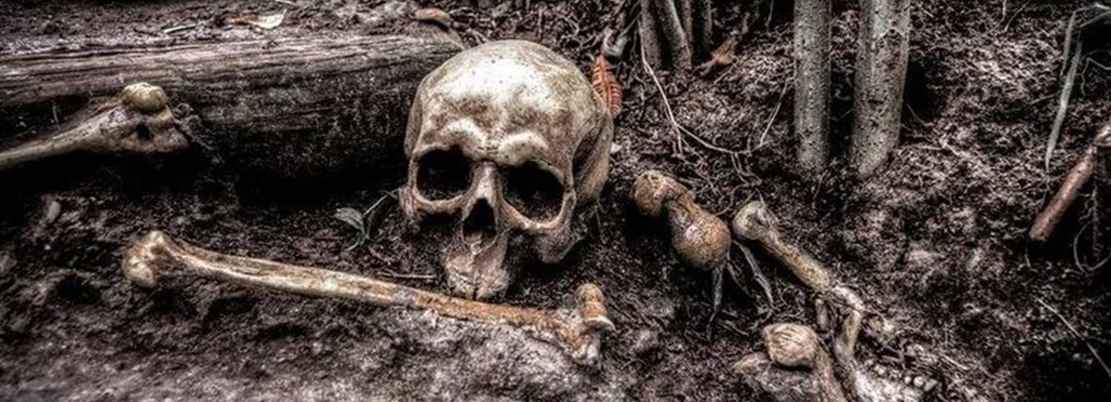
Creature extinction
A rise of 1.5°C could cause 30% of species to become extinct.

Slide 4
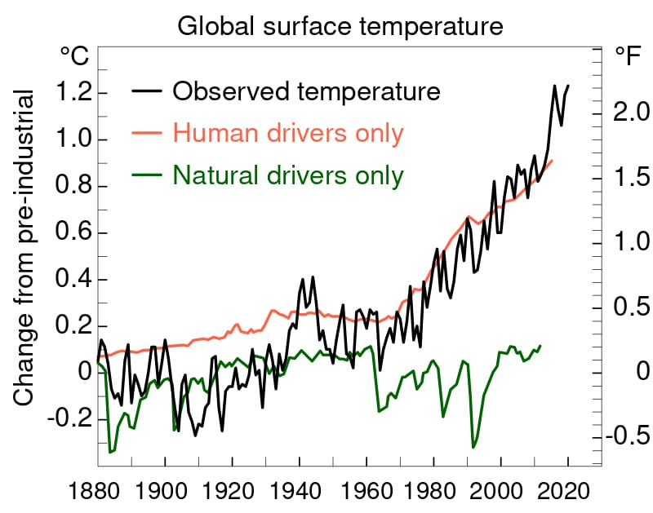
The average global temperature rise is about 1.2°C higher than it was in preindustrial times.
This is already leading to sweltering heat waves.

Slide 5
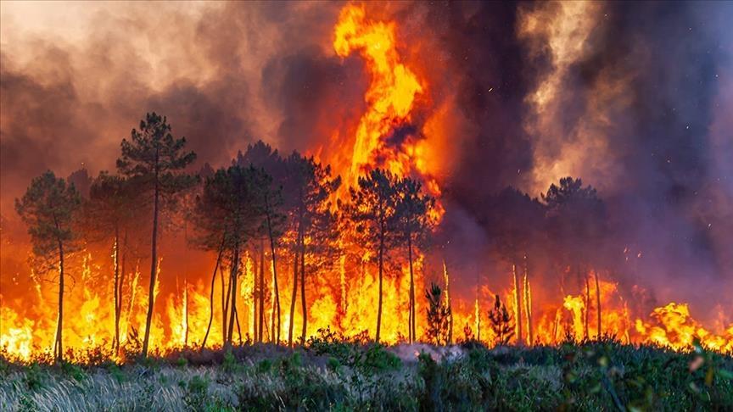
Forest fires
Climate change increases hot and dry conditions that help fires spread faster, and also leads to longer duration and increased fire intensity. In the Mediterranean, this contributed to the early start of the fire season and more land burning. Last year more than 24,000 acres burned in the European Union, making it the second worst wildfire season in the bloc after 2017.

Slide 6
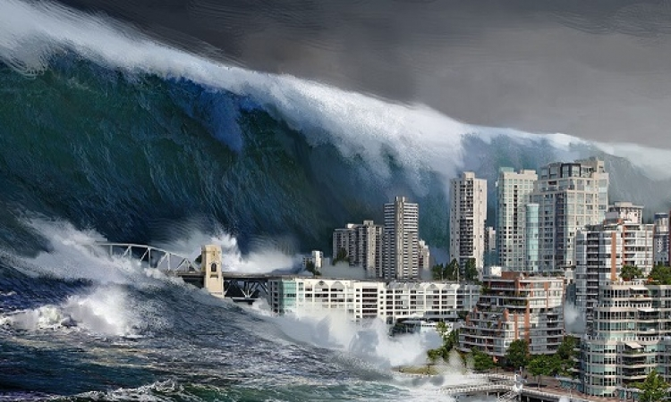
Flood danger
Coastal flooding will continue to increase as sea levels rise, melting glaciers and ice sheets add volume to the ocean, and the water itself expands as it warms, which could pose a major threat to the inhabitants of the planet.

Slide 7
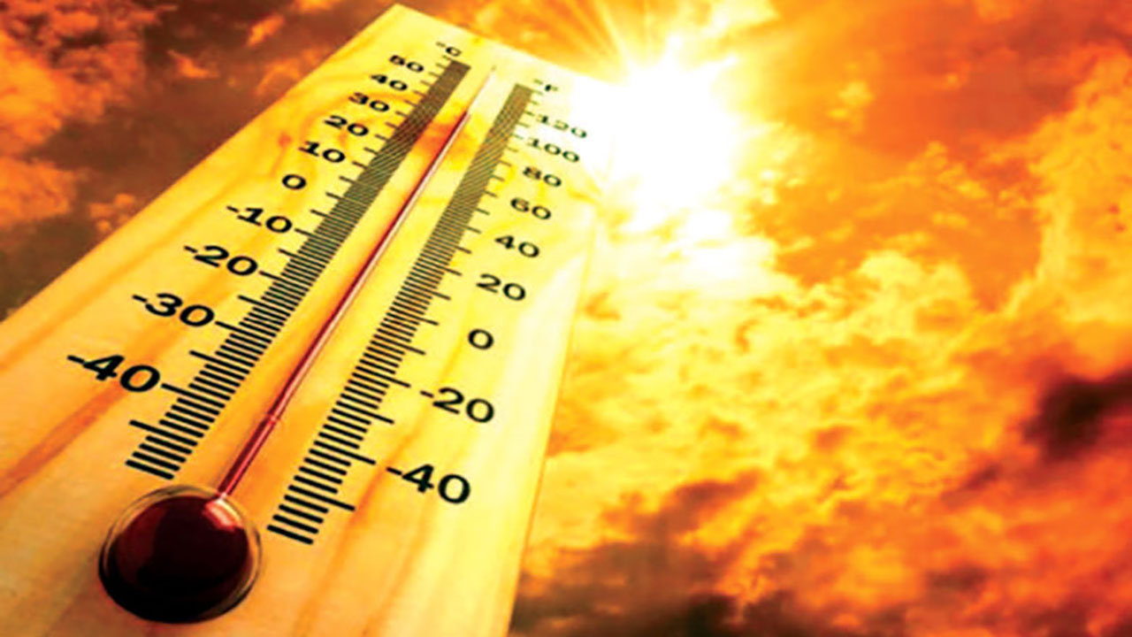
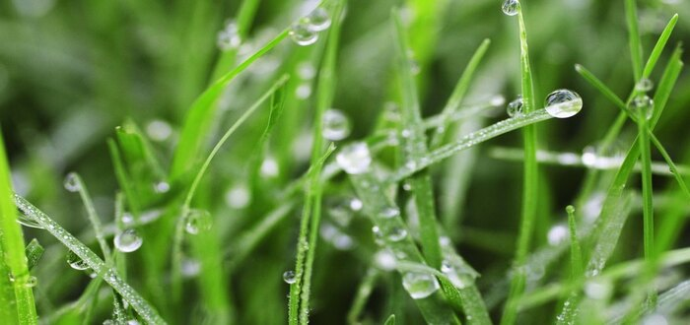
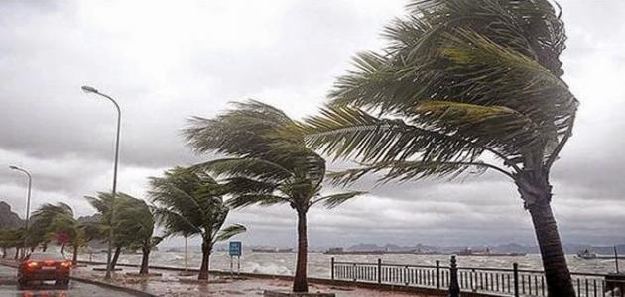
Factors affecting forest fires & flood dangers
Temperature
Humidity
Wind Speed

Slide 8
How can we begin to focus so much of our efforts on solving this problem?!

Slide 9

There are a lot of things we don't know about planet Earth, and advanced machine learning can provide the magic solution, helping us unlock the secrets of Earth's atmosphere, oceans and cryosphere. Artificial intelligence will become a key factor in forecasting the worst weather, alerting to heavy rains, hurricanes and other situations such as global warming. Artificial intelligence is also being developed to track the source of air pollution.

